Slide 1
Car Safety System Final Product
Group 16
Sihan Chen
Jiacheng Xing
Qinqing Huang
Haoze Feng
Yunliang Han
Xin Wu

Slide 2

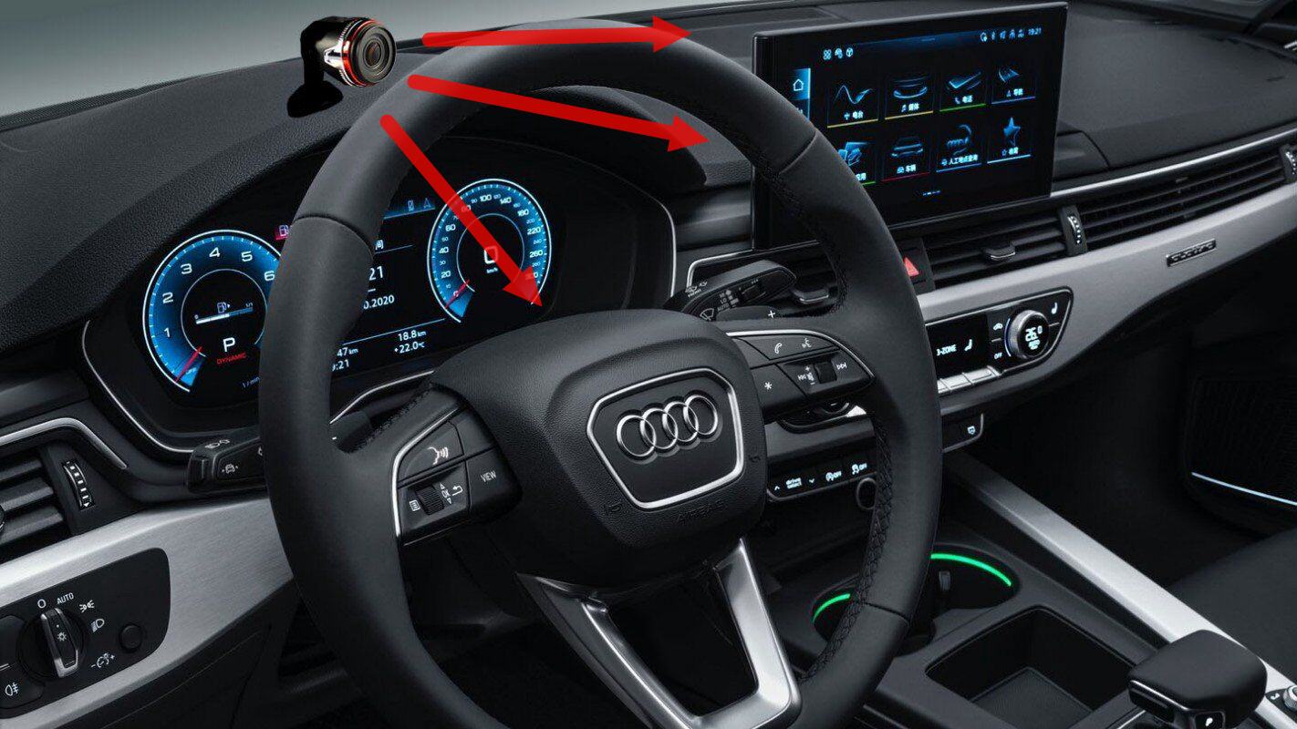
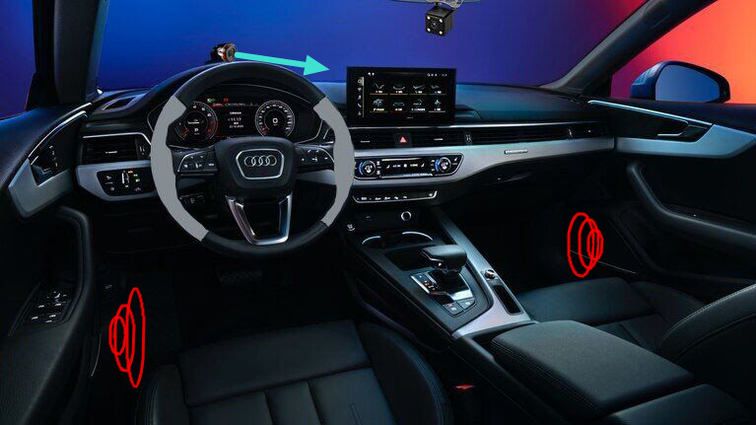
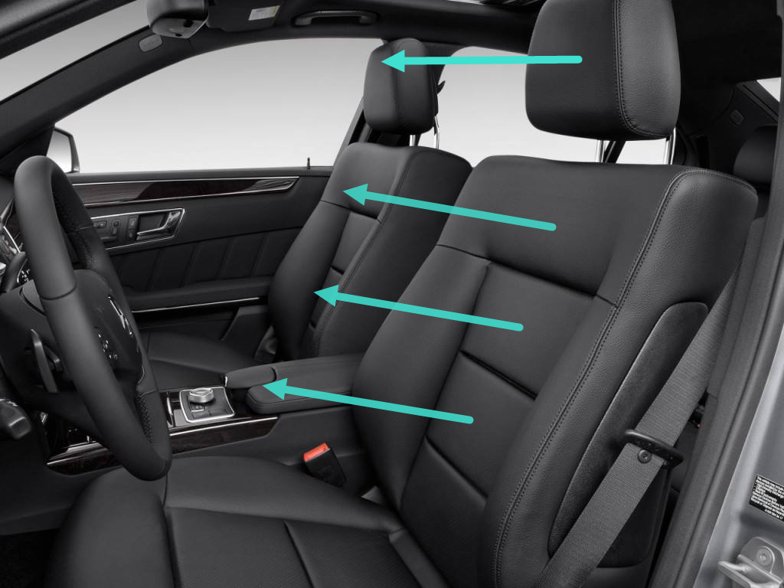
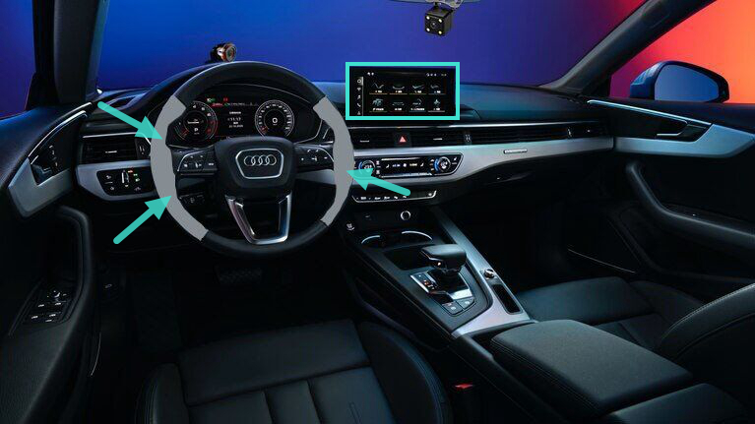
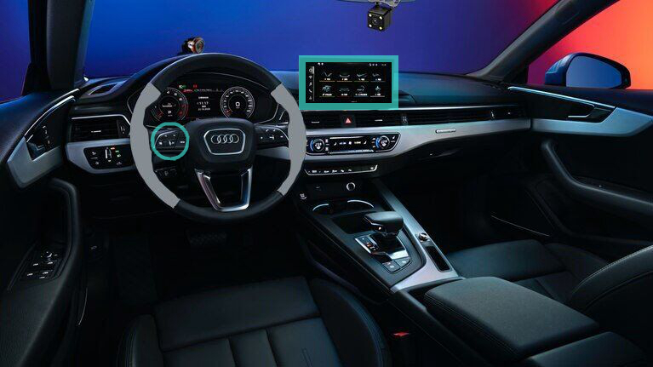
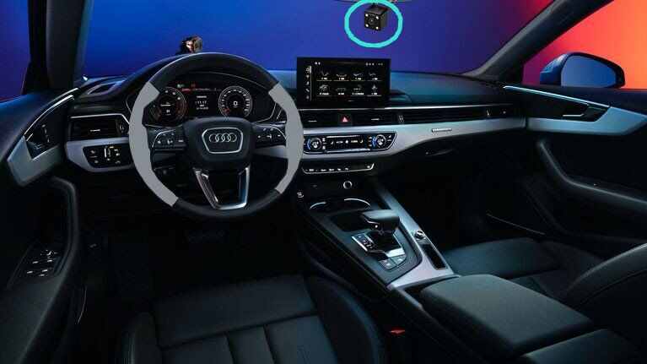
Final prototype

Slide 3
Prototype of Central Console

Slide 4
Prototype of Phone APP

Slide 5
Thank you!

